Slide 1
Dispelling Software Engineering Myths:
A Pragmatic Causal Inference Approach
Thesis Proposal, March 9, 2026
Hao He
haohe@andrew.cmu.edu
Ph.D. Student in Software Engineering
Carnegie Mellon University

Slide 2
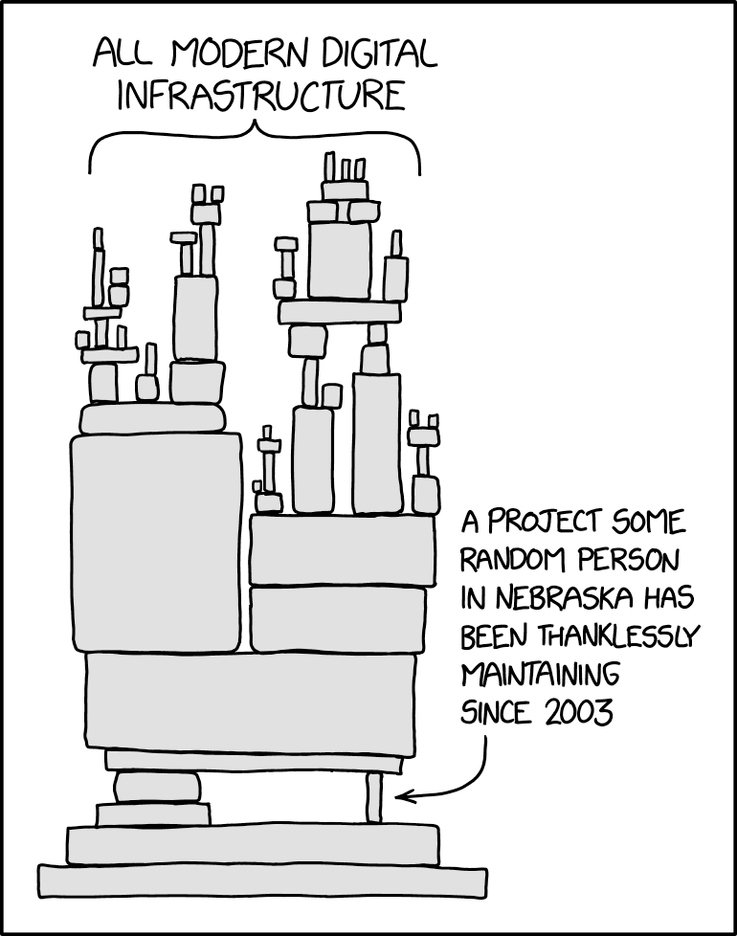
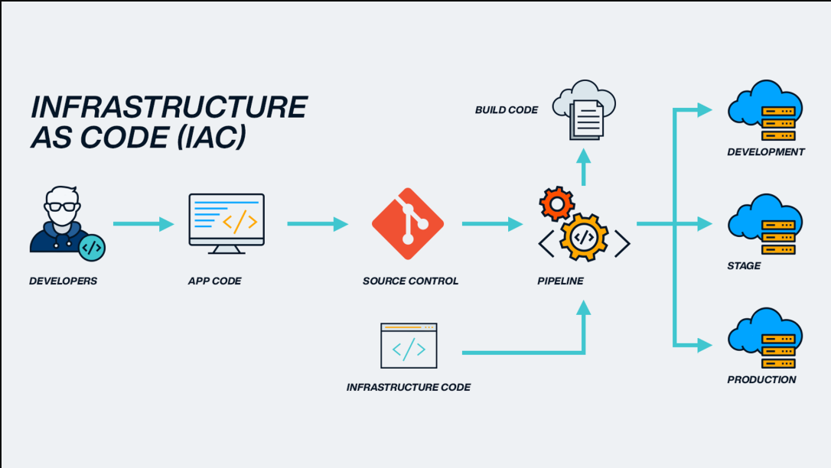
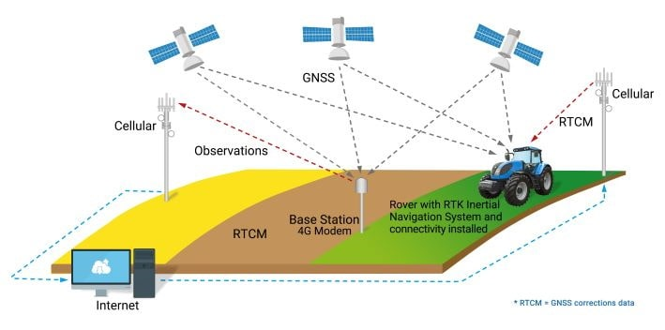

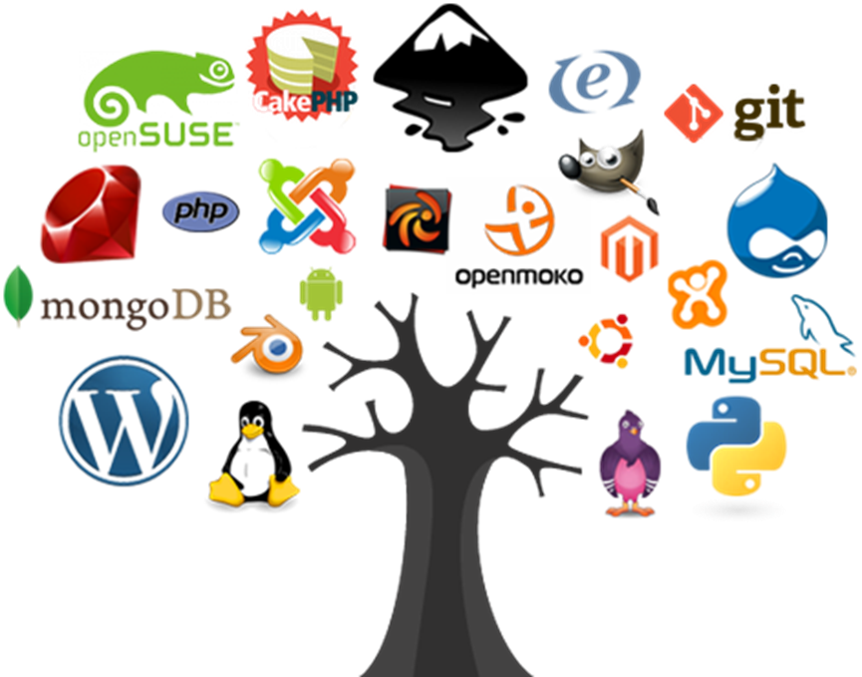
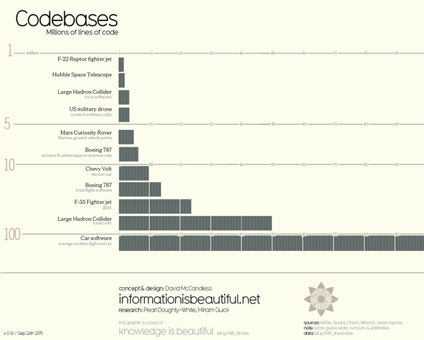
Software engineering is one of the most consequential engineering disciplines in the modern era

Slide 3

However, software engineering practice today is filled with myths
Software Engineering Myths: widely held beliefs derived from intuition, experience, and conventional wisdom, that have never been rigorously tested or, when tested, have produced inconclusive or contradictory results

Slide 4
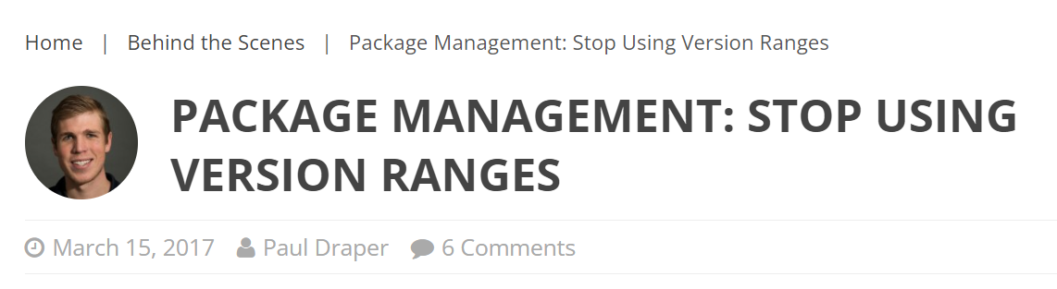
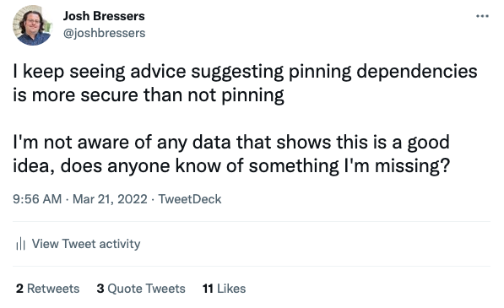
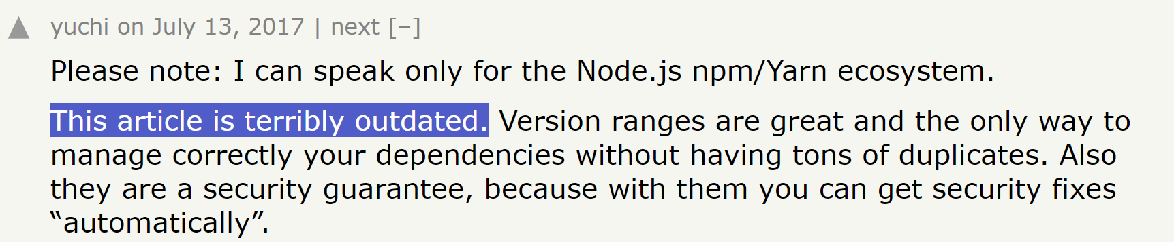
Example 1: Pinning vs. Floating

Slide 5
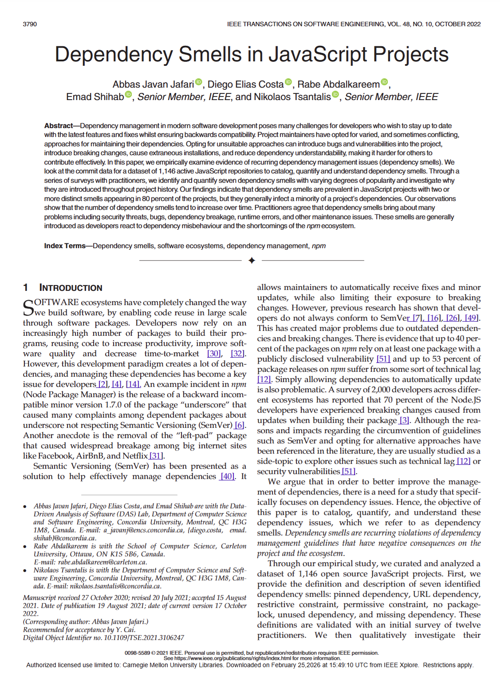
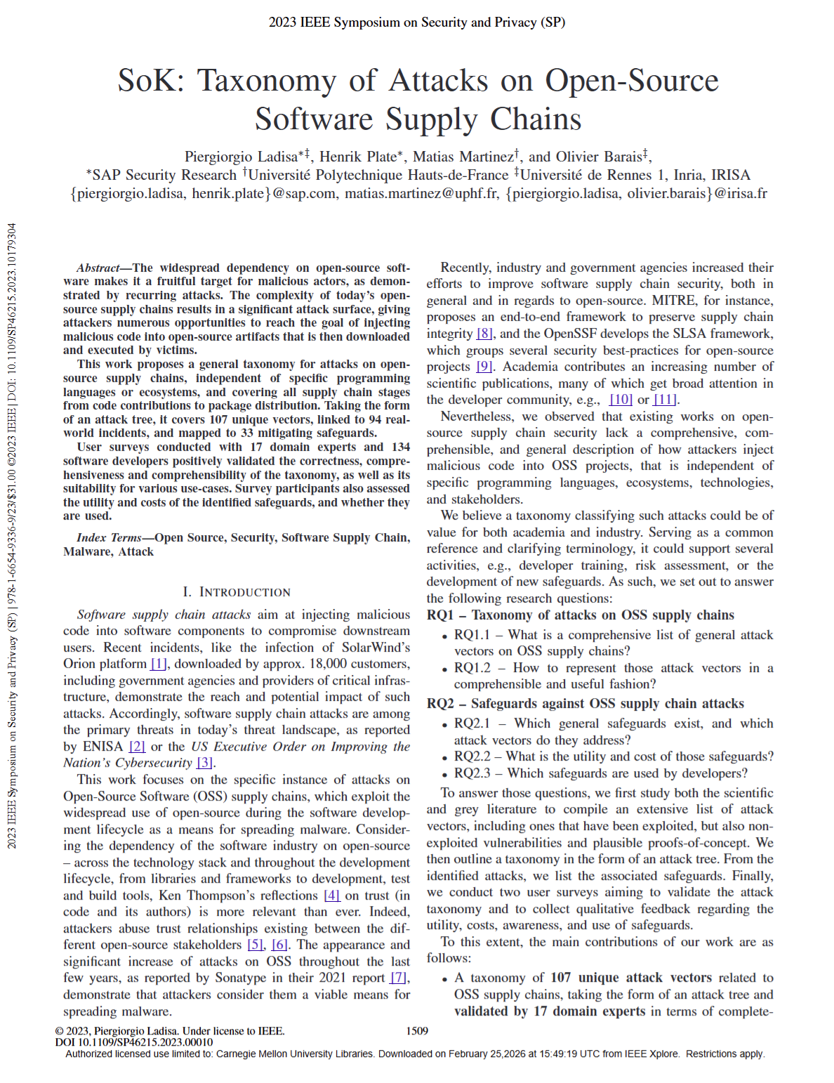
Example 1: Pinning vs. Floating
By pinning a dependency, we will not receive important security and bug fixes…It therefore leaves our project less and less secure over time
… and version pinning show the highest utility/cost ratio, thus, are considered to be useful and cheap controls (against supply chain attacks)

Slide 6

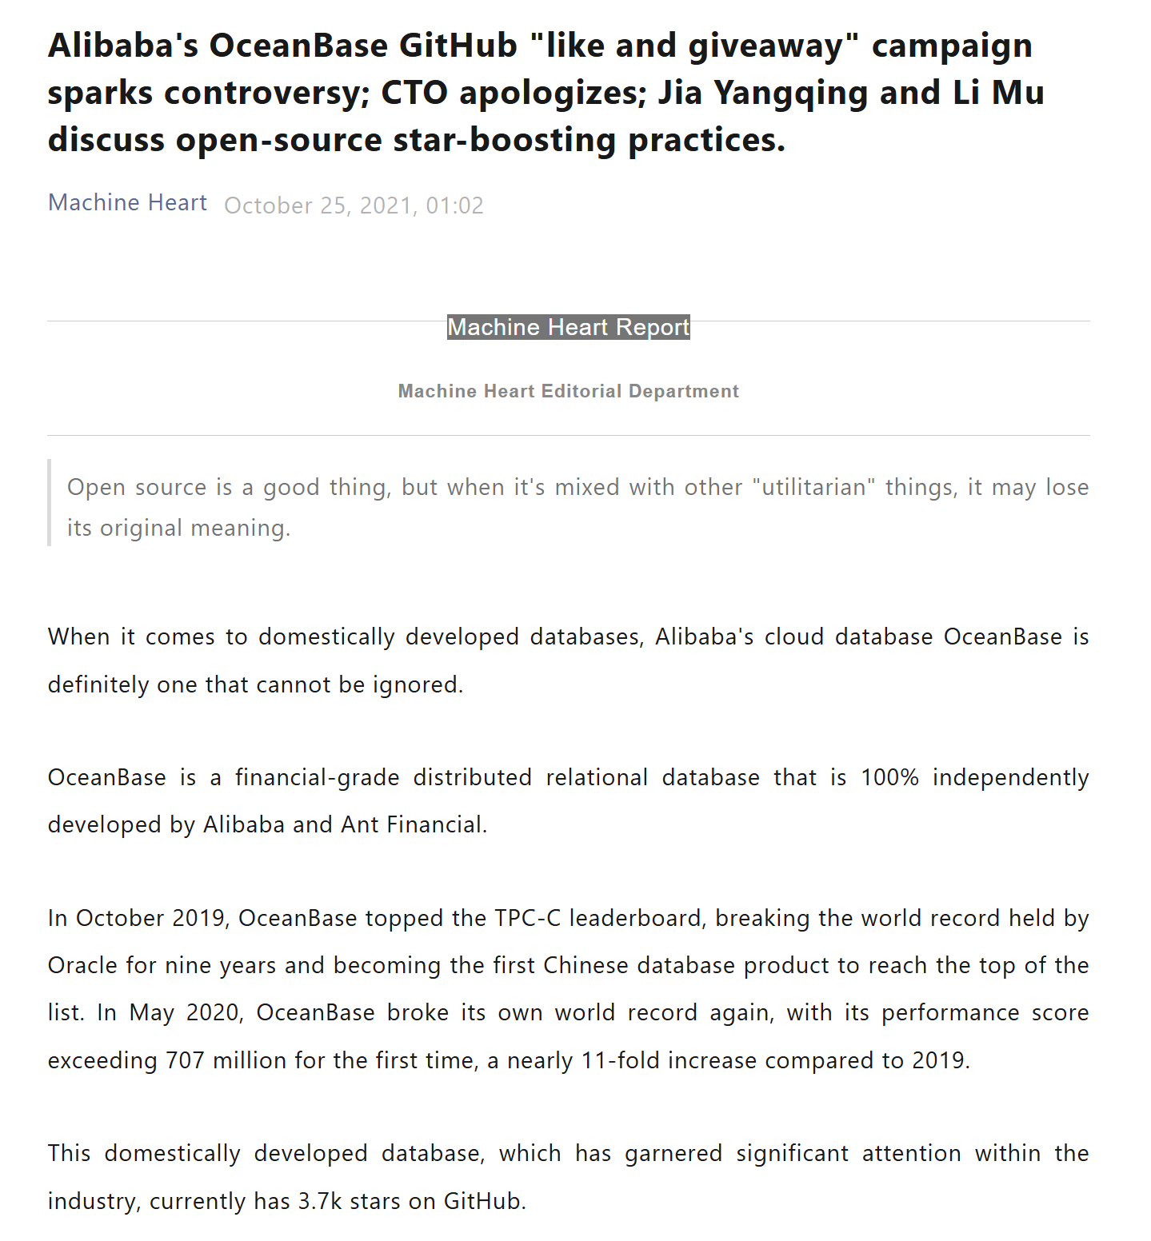
Example 2: GitHub Stars for Growth Hacking

Slide 7

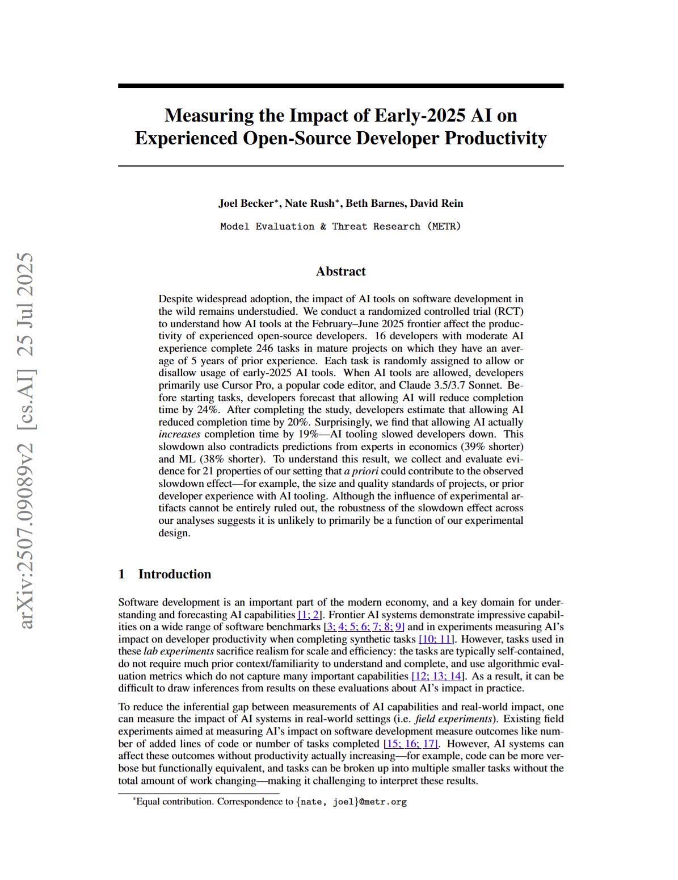
Example 3: AI Coding Tools on Productivity
Open-source developers work on their daily tasks slower with Cursor AI in early 2025

Slide 8
Example 4: Programming Language vs. Defect Proneness
Does the choice of programming language affect defect proneness (i.e., how prone your code is subject to bugs)?
Static Typing vs. Dynamic Typing
Functional vs. Procedural vs OOP
Memory Safety by Design vs. Manual Memory Management

Slide 9
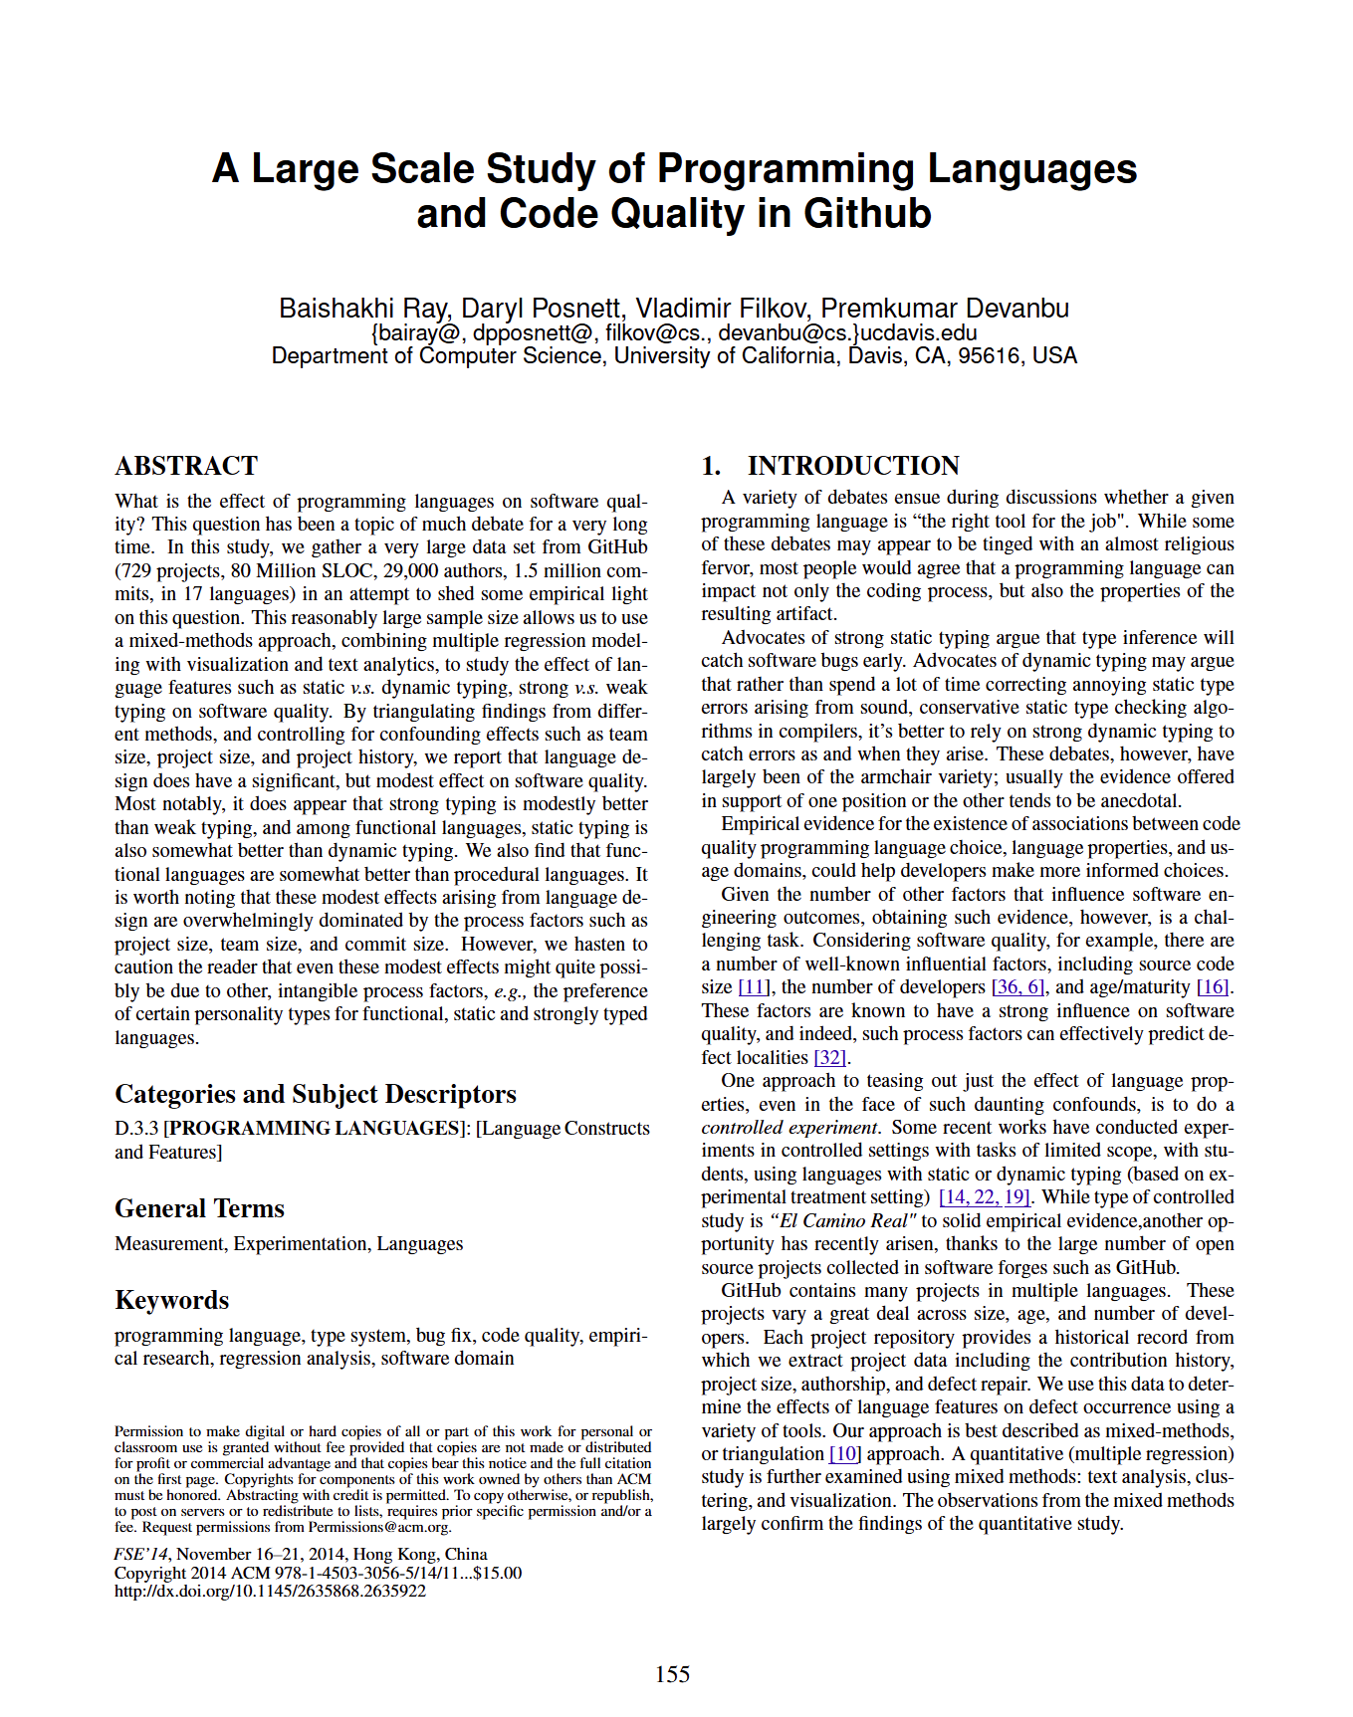


Example 4: Programming Language vs. Defect Proneness

Slide 10
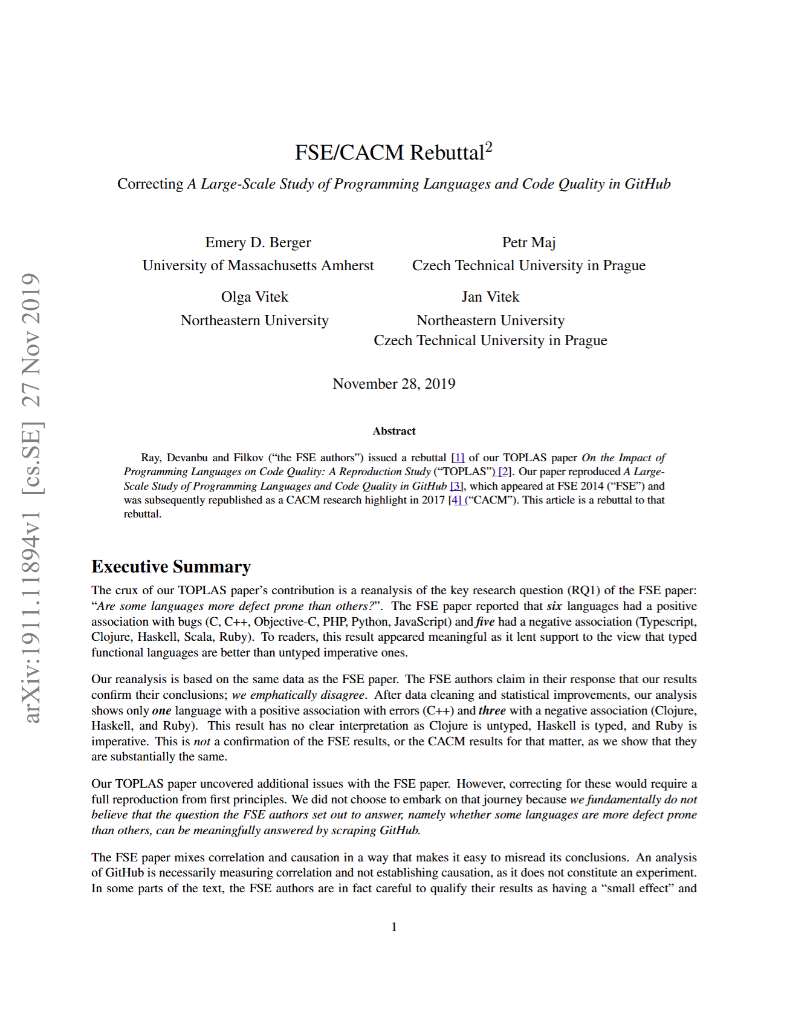
Example 4: Programming Language vs. Defect Proneness
“We fundamentally do not believe that the question the FSE authors set out to answer, namely whether some languages are more defect prone than others, can be meaningfully answered by scraping GitHub.”
Is mining software repository research over?
Is there a way to meaningfully settle controversies on important software engineering myths?

Slide 11


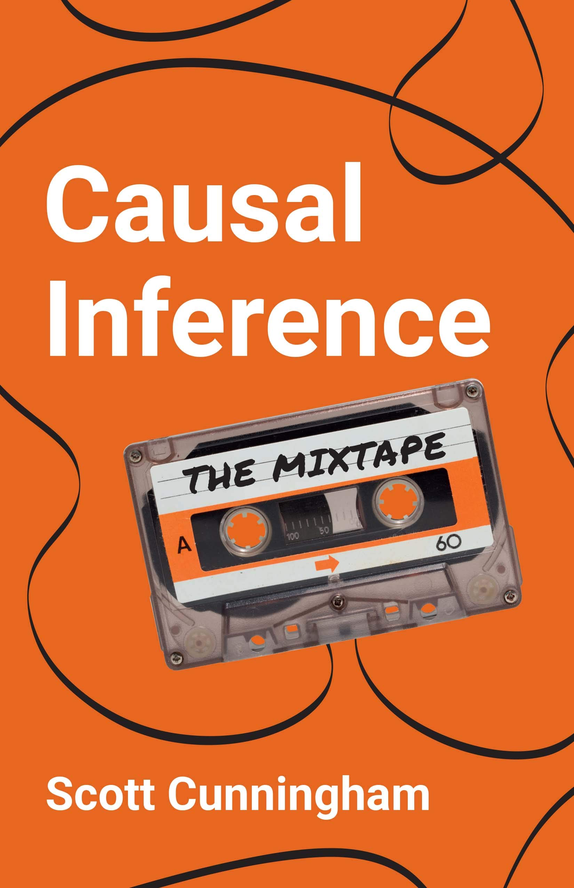
The Art of Causal Inference on Observational Data

Slide 12
The Modern Weaponry for Causal Inference
Regression Discontinuity Design
Matching
Difference in Differences
Fixed Effects and Panel Regression
Randomized Experiments
Natural Experiments
Instrumental Variables
High Internal Validity
High External Validity

Slide 13
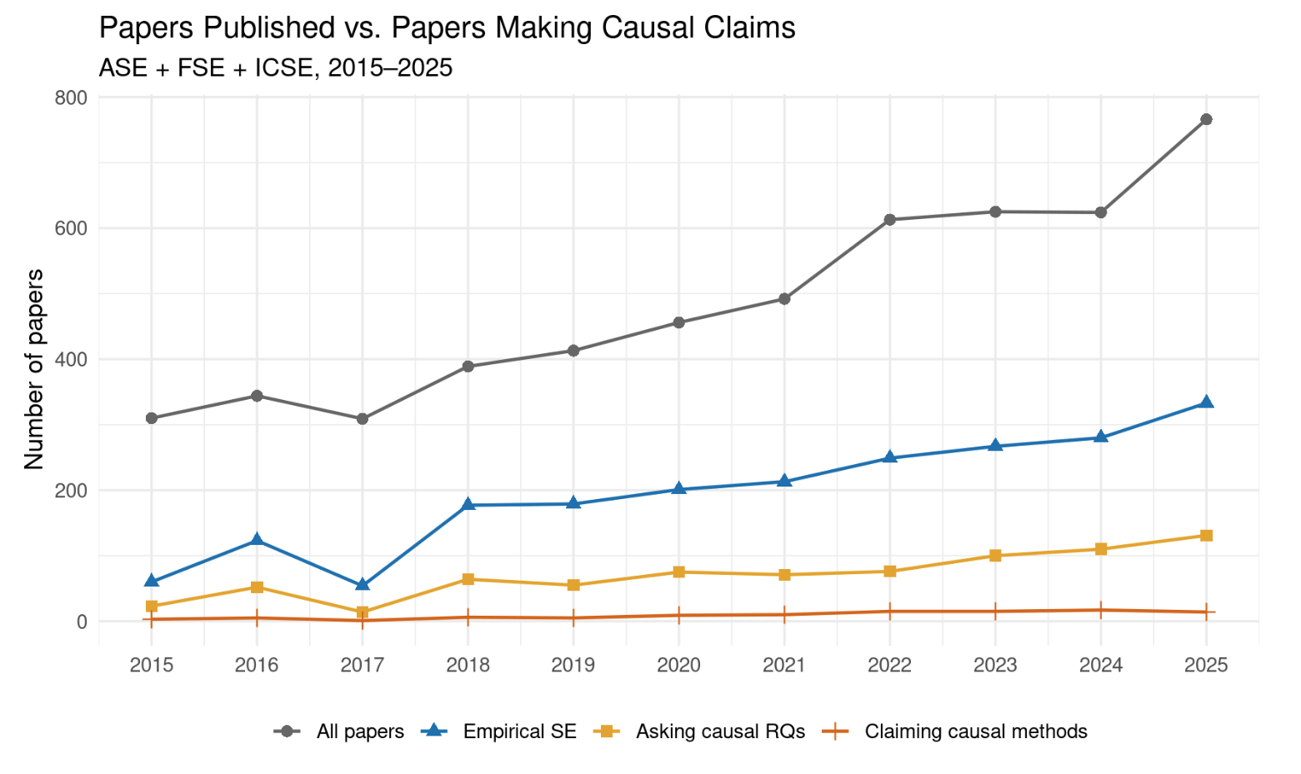
It has been used in software engineering, but not that much

Slide 14
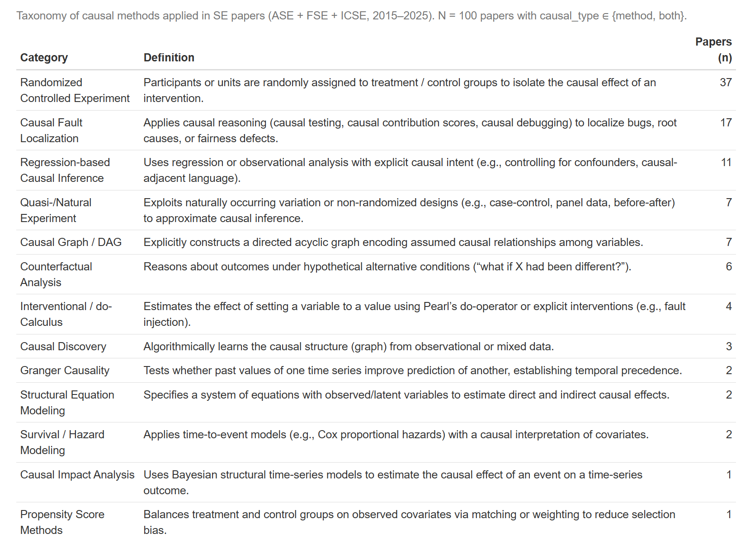

Slide 15
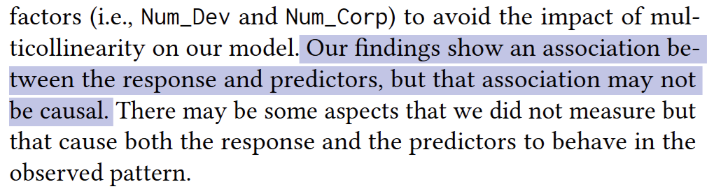
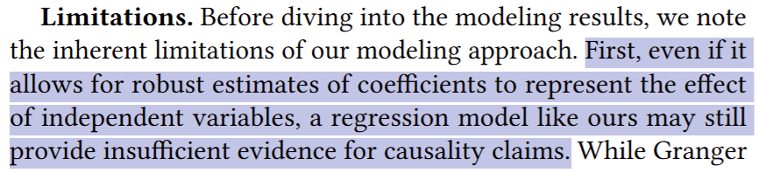
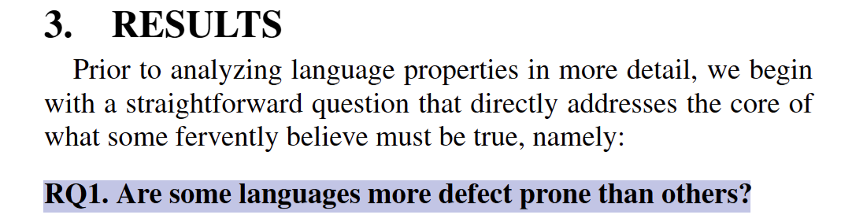
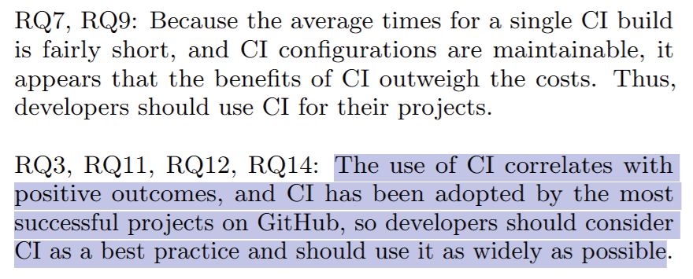
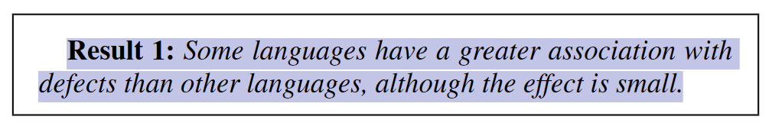
Common Pattern: Claiming to be only studying correlation when the research question is fundamentally a question about causal relationships

Slide 16
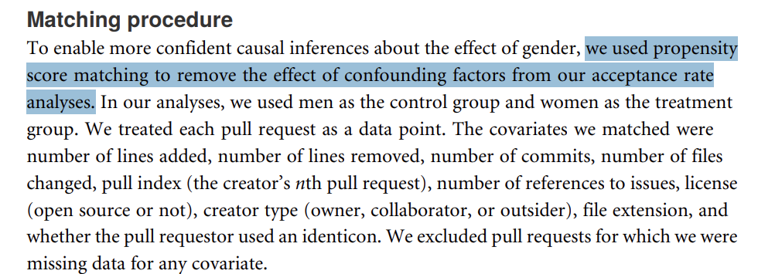
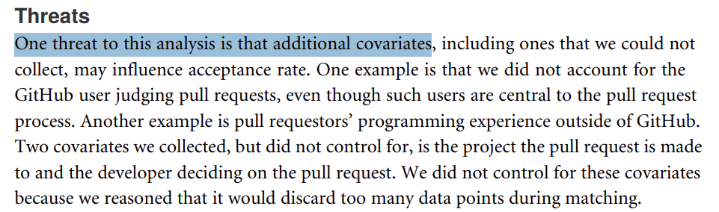
Even a “causal inference” method is claimed, SE research may fail to discuss the nuance of underlying assumptions and when you can make a causal claim
Example: Use propensity score matching without assessing the conditional ignorability assumption
Example: Believe that experiment is golden standard without assessing if randomization can be truly achieved
  Believe that a small sample (N=30) achieve sufficient randomization
  Randomization on non-randomizable treatment
    e.g., compare men vs. women in software engineering
    => strong selection bias in place

Slide 17
Without a framework and language of causal credibility, one has to be an expert to assess the strength of causal claims in each paper

Slide 18
Thesis Statement
I argue that empirical SE research needs an explicit framework and vocabulary for causal credibility assessments so that it can better dispel software engineering myths and inform evidence-based practice
A causal credibility assessment from a pragmatic angle shall include
  A causal theory explicitly defined as directed acyclic graphs (DAGs),
  The causal estimate of interest and the assumption under which the estimate would carry a causal interpretation, defined through the potential outcome framework
  Honest acknowledgment and mitigation attempts of limitations in data collection, metric design, and model specifications
  thoughtful navigation of alternative explanations (i.e., alternative DAGs)
Notes:
Applying the thesis framework is feasible for dispelling software engineering myths and inform evidence-based practice. Do an educational paper instead of the migration

Slide 19
Expected Thesis Contributions
A framework that systematizes causal inference practices in SE and provides a vocabulary for SE researchers to assess causal credibility and make causal claims
Examples of applying this framework to well-known software engineering myths
  The impact of pinning vs floating on supply chain security
  The impact of buying GitHub stars for popularity growth
  The impact of adopting AI coding tools on velocity and quality
  The impact of programming language on defect-proneness
Each example provides novel empirical evidence to inform practices in important software engineering problems

Slide 20
Completed Work: Pinning vs. Floating
Research Question: Does pinning dependency versions affect software projects’ vulnerability to software supply chain attacks?
reduces
Pinning Dependencies
Attack Surface
Candidate Theory (The Myth)
He, Hao, Bogdan Vasilescu, and Christian Kästner. "Pinning is Futile: You Need More Than Local Dependency Versioning to Defend Against Supply Chain Attacks." Proceedings of the ACM on Software Engineering 2.FSE (2025): 266-289. 🏆Distinguished Paper Award

Slide 21
Completed Work : Pinning vs. Floating
Research Question: Does pinning dependency versions affect software projects’ vulnerability to software supply chain attacks?
Dependency Graph Size
mediates
Pinning Dependencies
Attack Surface
mediates
Dependency Resolution Algorithm
Alternative Theory
He, Hao, Bogdan Vasilescu, and Christian Kästner. "Pinning is Futile: You Need More Than Local Dependency Versioning to Defend Against Supply Chain Attacks." Proceedings of the ACM on Software Engineering 2.FSE (2025): 266-289. 🏆Distinguished Paper Award

Slide 22
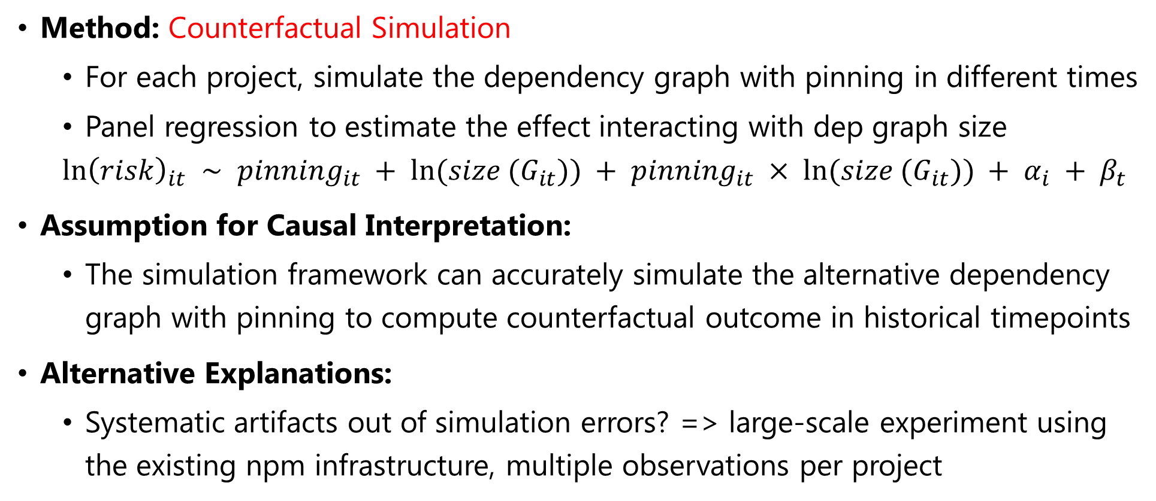
Completed Work: Pinning vs. Floating
Method: Counterfactual Simulation
  For each project, simulate the dependency graph with pinning in different times
  Panel regression to estimate the effect interacting with dep graph size
  $$ln{\left(risk\right)}_{it} ∼ pinning_{it} + ln(size (G_{it})) + pinning_{it} × ln(size (G_{it})) + α_{i} + β_{t}$$
Assumption for Causal Interpretation:
  The simulation framework can accurately simulate the alternative dependency graph with pinning to compute counterfactual outcome in historical timepoints
Alternative Explanations:
  Systematic artifacts out of simulation errors? => large-scale experiment using the existing npm infrastructure, multiple observations per project

Slide 23
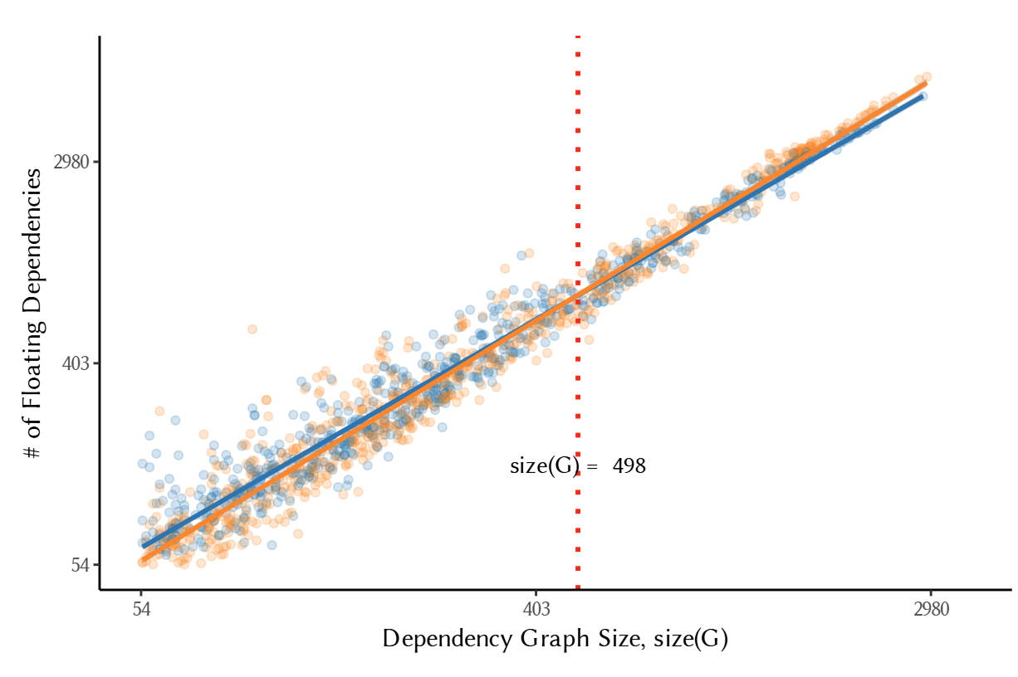
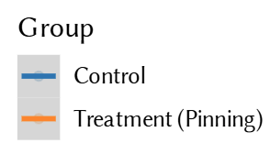
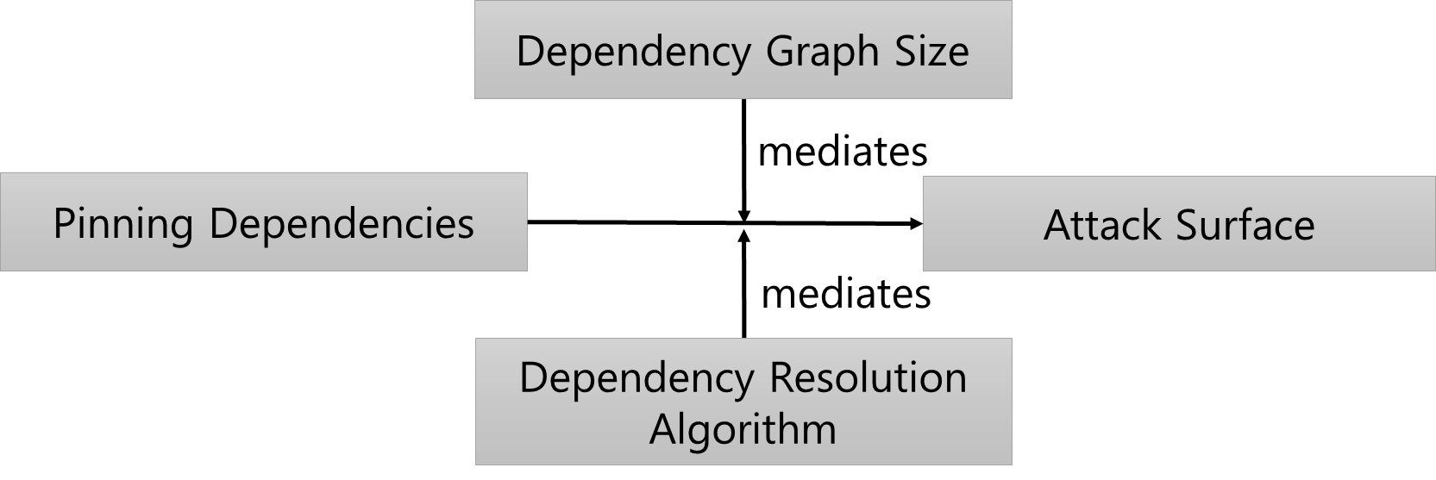
Completed Work: Pinning vs. Floating
×(dispelled) Candidate Theory 1 (The Myth)
√(supported) Candidate Theory 2

Slide 24
Completed Work: The Effect of Fake GitHub Stars
Research Question: Does artificially inflating GitHub stars create a promotional effect, making people more likely to star the target repositories?
increases
Fake GitHub Stars
Real GitHub Stars
Candidate Theory (The Myth)
He, Hao, et al. "Six Million (Suspected) Fake Stars on GitHub: A Growing Spiral of Popularity Contests, Spam, and Malware." Proceedings of the 48th International Conference on Software Engineering (ICSE’26). 2026.

Slide 25
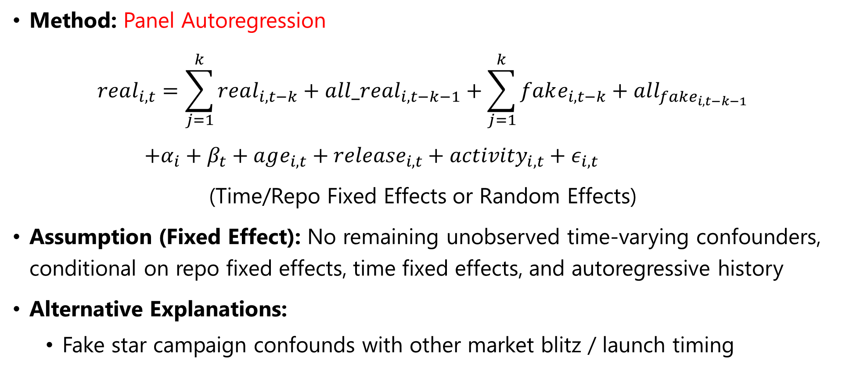
Completed Work: The Effect of Fake GitHub Stars
Method: Panel Autoregression
$$real_{i,t}=\sum_{j=1}^{k}{real_{i,t−k}+all_real_{i, t−k−1}}+\sum_{j=1}^{k}{fake_{i,t−k}}+all_{fake_{i,t−k−1}}$$
$+α_{i}+β_{t}+age_{i,t}+{release}_{i,t}+activity_{i,t}+ε_{i,t}$
(Time/Repo Fixed Effects or Random Effects)
Assumption (Fixed Effect): No remaining unobserved time-varying confounders, conditional on repo fixed effects, time fixed effects, and autoregressive history
Alternative Explanations:
  Fake star campaign confounds with other market blitz / launch timing

Slide 26
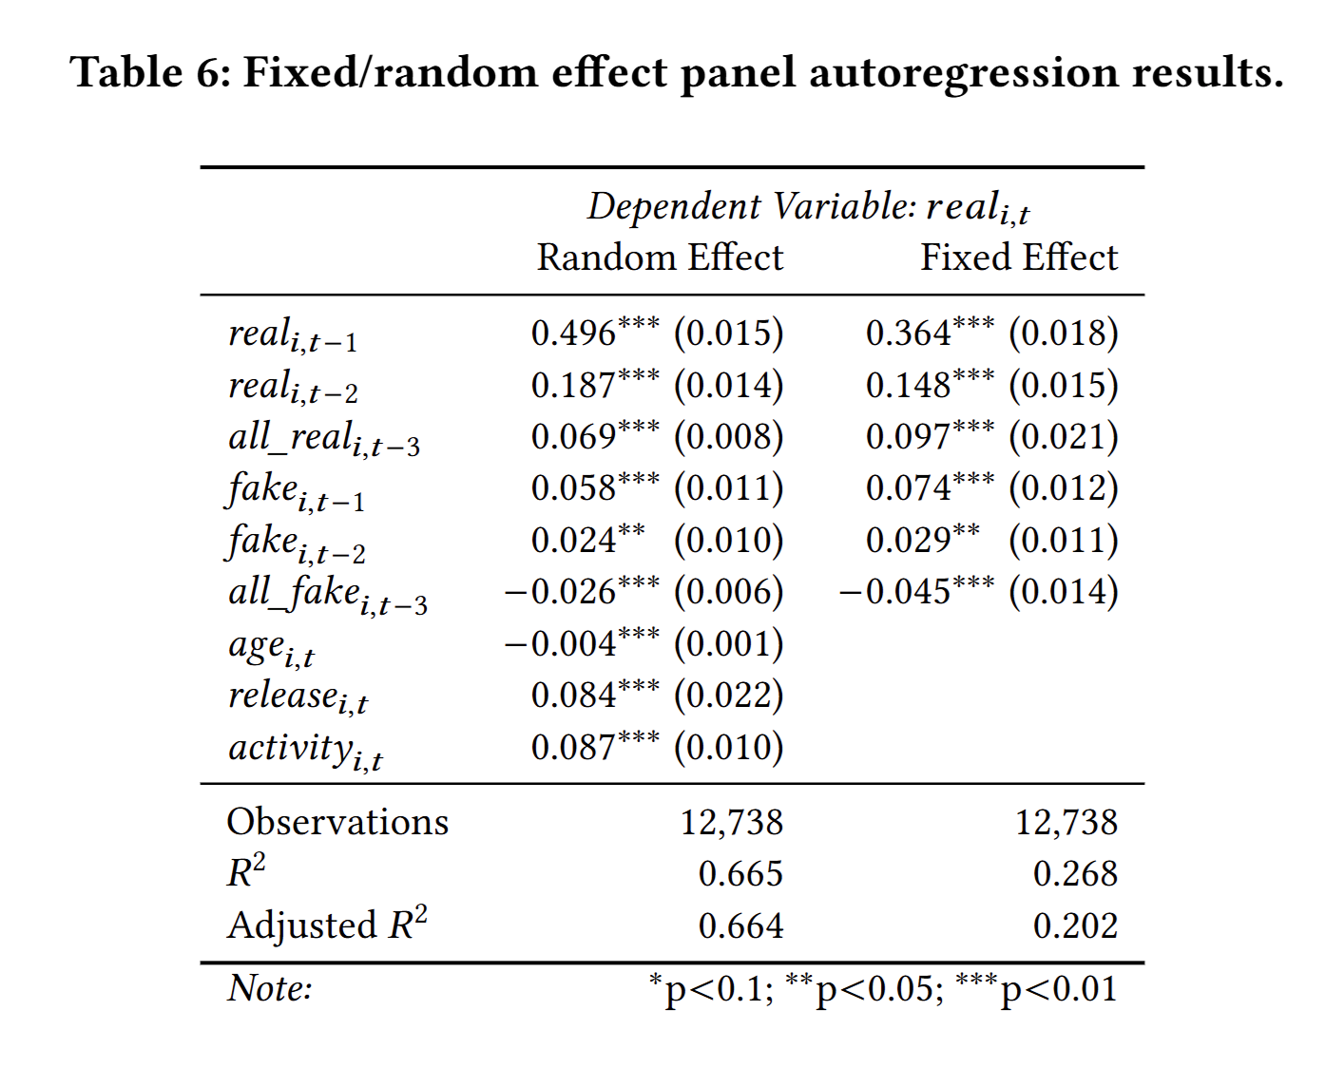
Completed Work: The Effect of Fake GitHub Stars
Fake GitHub Stars
increases
decreases
Short Term Real Stars
Long Term Real Stars
√(supported) Alternative Theory

Slide 27
Completed Work: The Impact of Cursor AI Adoption
Research Question: Does Cursor bring sustained productivity benefits to software development (as measured by development velocity and software quality)?
increases
Cursor AI
Development Velocity
increases
Cursor AI
Software Quality
Candidate Theory (The Myth)
He, Hao, et al. "Speed at the Cost of Quality: How Cursor AI Increases Short-Term Velocity and Long-Term Complexity in Open-Source Projects." arXiv preprint arXiv:2511.04427 (2025). To appear in the 2026 23rd International Conference on Mining Software Repositories.

Slide 28
Completed Work: The Impact of Cursor AI Adoption
Method: Propensity Score Matching + Staggered Difference-in-Differences
Assumption for Causal Interpretation:
  (Parallel Trend) The treatment group and the control group would on average evolve similarly in outcome should the treatment (i.e., Cursor) never happened
Alternative Explanations:
  (Selection Bias) The two groups are different => matching + pre-trend tests
  (Sustainability Issues) Developers abandon the project => Robustness checks
  (Non-compliance) Developers stop using Cursor => Robustness checks
  (Dataset Pollution) Presence of other AI tools => Robustness checks

Slide 29
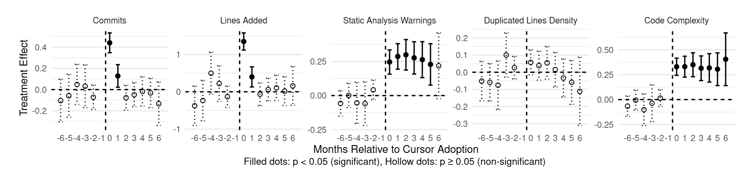
Completed Work: The Impact of Cursor AI Adoption
increases
Cursor AI
Development Velocity
increases
Cursor AI
Software Quality
×(dispelled) Candidate Theory (The Myth)

Slide 30
Completed Work: The Impact of Cursor AI Adoption
Frustration & Abandonment
-
Cursor AI Adoption
+
-
+
+
+
Velocity
-
Static Analysis Warnings
Code Complexity
-
√(supported) Alternative Theory

Slide 31
Proposed Work: Revisiting the PL vs. Defect Proneness Debate

Slide 32
PL vs. Defect Proneness: A (Possible) Causal DAG
Domain
To be Tested
Language
Defect Proneness
Team Skill
Org Culture
Code Complexity
Codebase Legacy
Notes:
Add colliders, backdoor paths

Slide 33
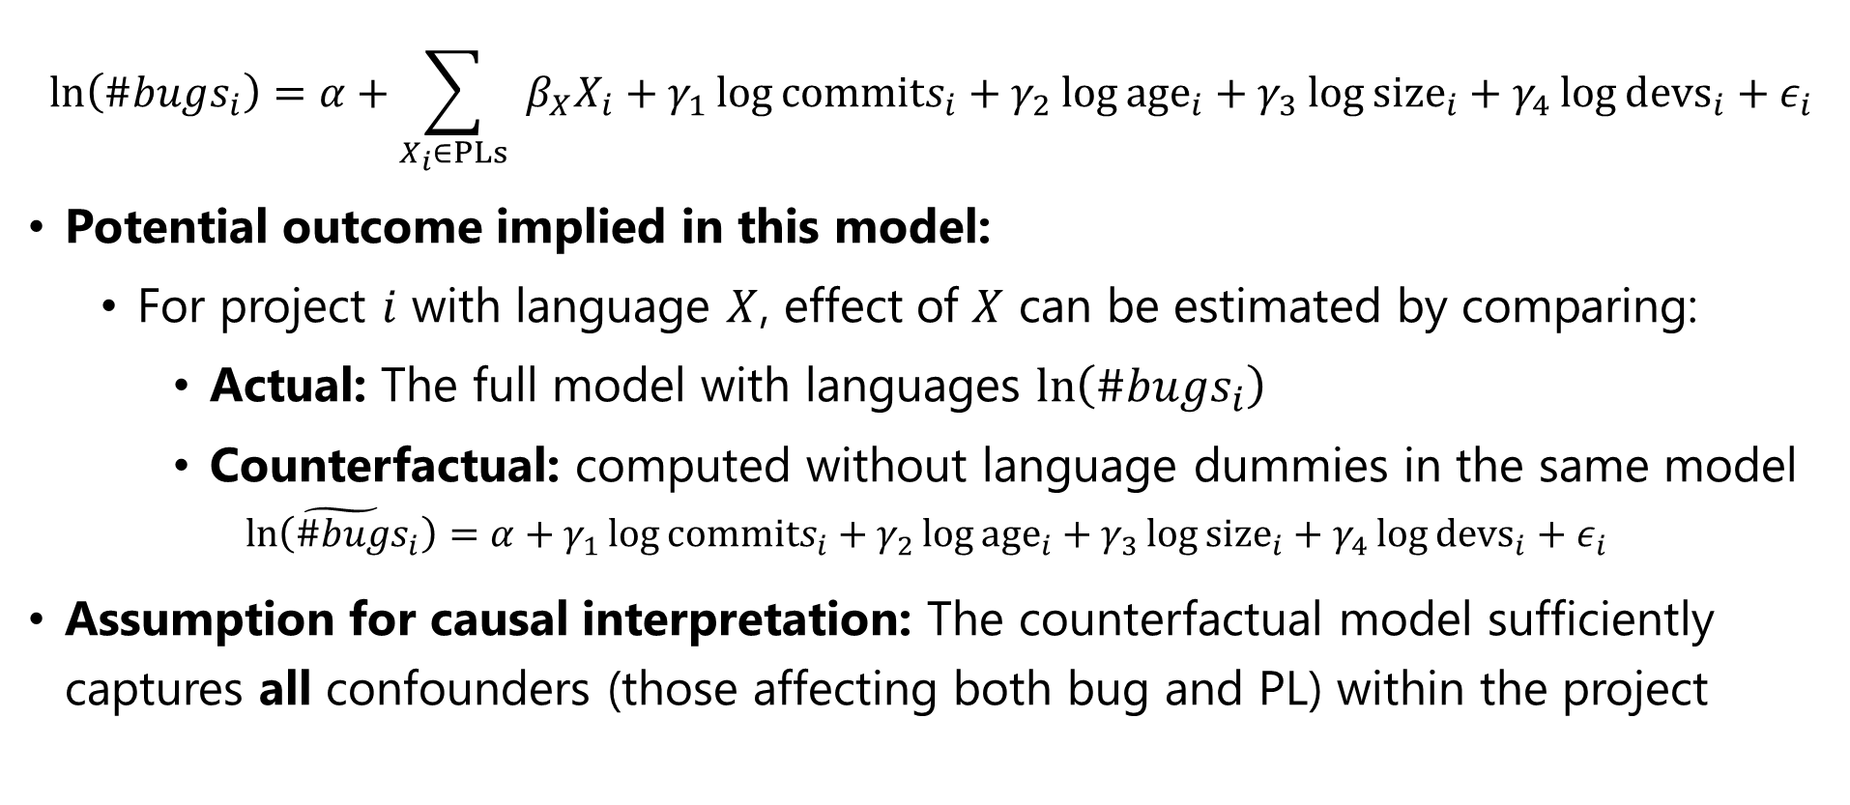
PL vs. Defect Proneness: Model Specification of Ray et al.
$$\ln\left(\#bugs_{i}\right)=α+\sum_{X_{i}∈PLs}{{ β}_{X}X_{i}}+γ_{1}\log{commits_{i}}+γ_{2}\log{age_{i}}+γ_{3}\log{{size}_{i}}+γ_{4}\log{devs_{i}}+ε_{i}$$
Potential outcome implied in this model:
  For project $i$ with language $X$, effect of $X$ can be estimated by comparing:
    Actual: The full model with languages $\ln\left(\#bugs_{i}\right)$
    Counterfactual: computed without language dummies in the same model
      $$\tilde{\ln\left(\#bugs_{i}\right)}=α+γ_{1}\log{commits_{i}}+γ_{2}\log{age_{i}}+γ_{3}\log{{size}_{i}}+γ_{4}\log{devs_{i}}+ε_{i}$$
Assumption for causal interpretation: The counterfactual model sufficiently captures all confounders (those affecting both bug and PL) within the project

Slide 34
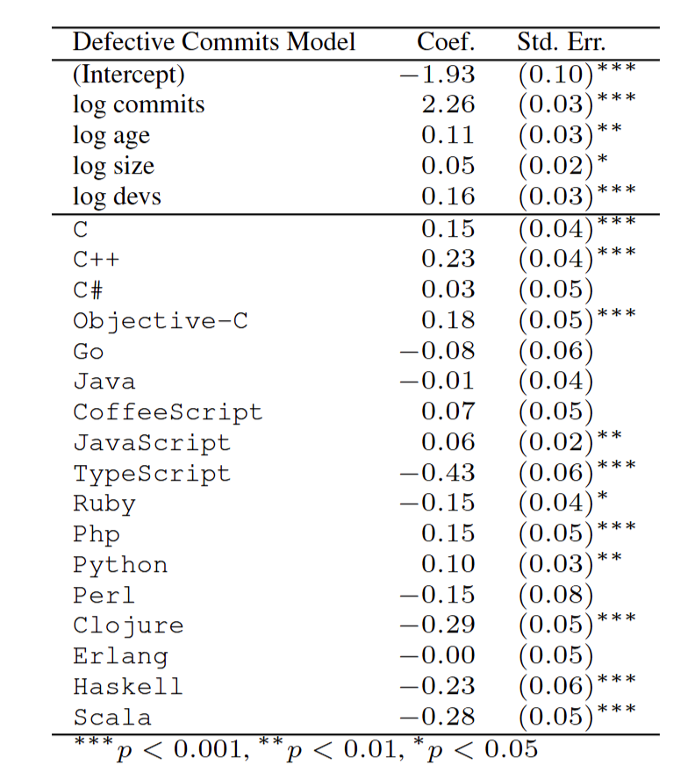
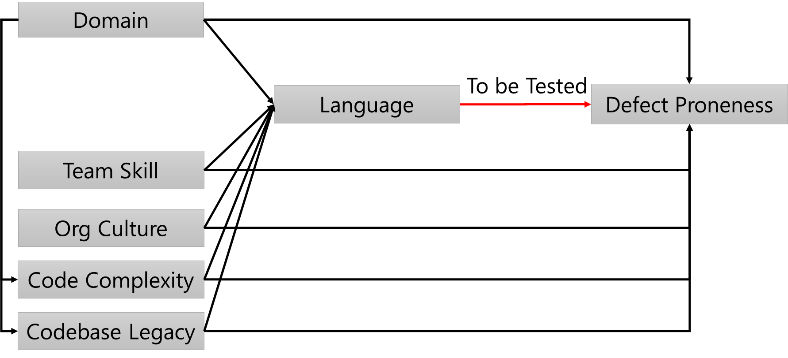
PL vs. Defect Proneness: What Confounders are Controlled Here?
log commits | Partially controls complexity / activity
log age | Controls codebase legacy
log size | Partially controls complexity / activity
log devs | Poor proxy of skills
(Partly Missing): Domain, Team Skill, Org Culture
× Assumption violated for causal interpretation

Slide 35
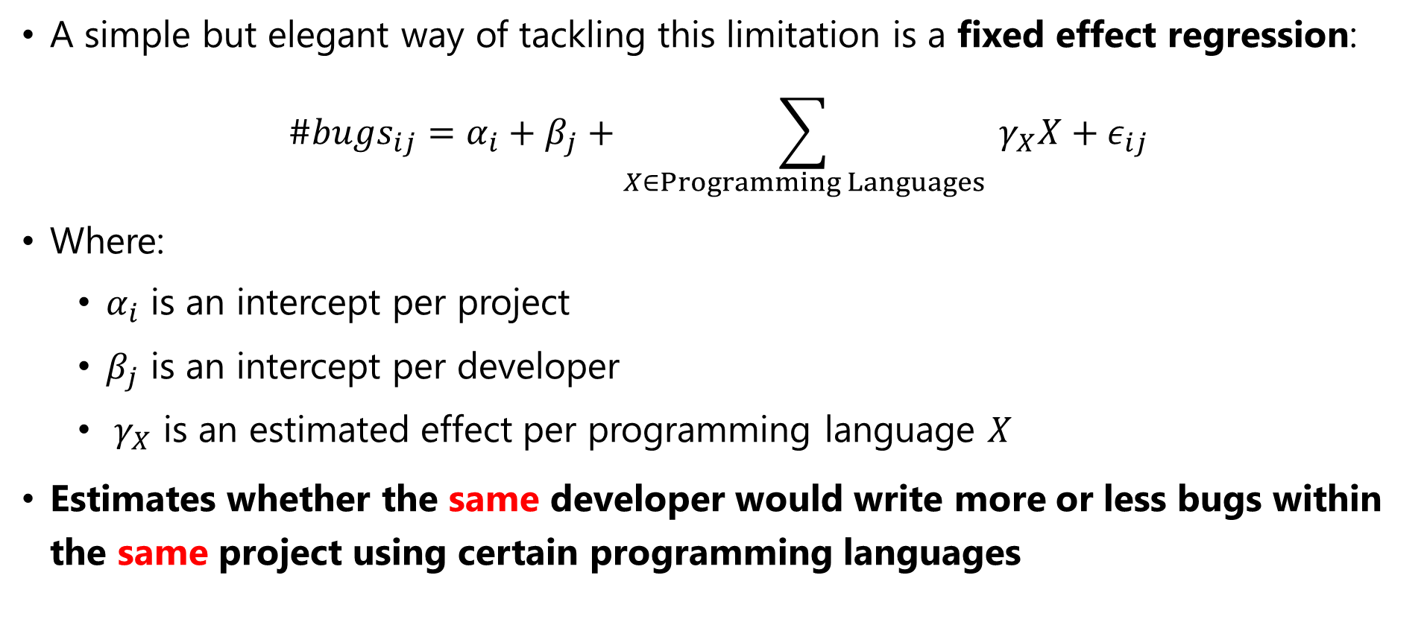
Proposed Work 1: Revisiting Ray et al. Dataset with Fixed Effects
A simple but elegant way of tackling this limitation is a fixed effect regression:
$$\#bugs_{ij}=α_{i}+β_{j}+\sum_{X∈Programming Languages}{{ γ}_{X}X}+ε_{ij}$$
Where:
  $α_{i}$ is an intercept per project
  $β_{j}$ is an intercept per developer
  ${ γ}_{X}$ is an estimated effect per programming language $X$
Estimates whether the same developer would write more or less bugs within the same project using certain programming languages

Slide 36
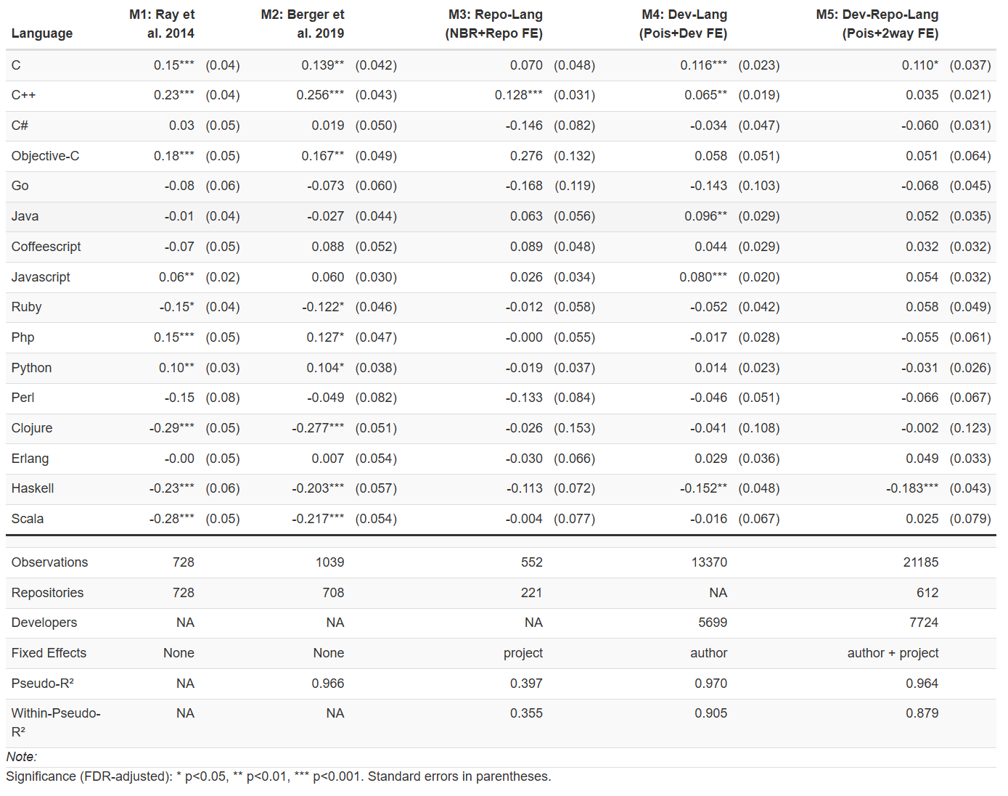
PL vs. Defect Proneness: Results from Two-Way Fixed Effects
Using Berger et al. cleaned version of Ray et al. dataset, I find that among the 15 studied programming languages:
  On average, the same developer would on average write more bugs in C and less bugs in Haskell in the same project
  Results from all other PLs are statistically insignificant

Slide 37
PL vs. Defect Proneness: Are We Good Yet?
Think about causal DAG and alternative explanations
  The project + developer two-way fixed effect design controls for the following factors that may also affect defect proneness within a project:
    developer expertise, taste, preference, intelligence, …
    project size, overall complexity, overall difficulty, overall culture, …
State the causal assumption clearly:
  Assumption: there is no unobserved factor affecting both defect proneness and developer’s choice of PL within a same project
  Under the above assumption, the regression discovers a causal relationship:
    using C => more bugs, and using Haskell => less bugs

Slide 38
PL vs. Defect Proneness: Are We Good Yet?
Assumption: there is no unobserved factor affecting both defect proneness and developer’s choice of PL within a same project
What if there is such a plausible unobserved factor?
E.g., in the same project, the same developer use C for lower-level tasks but Haskell for higher-level tasks, former being inherently more bug prone
Bug Proneness
Task Level of Abstraction (Low Level vs. High Level)
PL Choice

Slide 39
PL vs. Defect Proneness: Are We Good Yet?
Bug Proneness
Task Level of Abstraction (Low Level vs. High Level)
PL Choice
A fixed effect model not fitted on experimental data still carries the limitation of endogenous treatment selection: If one can argue a plausible mechanism as the example above, the model would not provide convincing causal evidence
To build stronger evidence, one can find settings that eliminates the above limitation by design, in the form of controlled or natural experiments

Slide 40
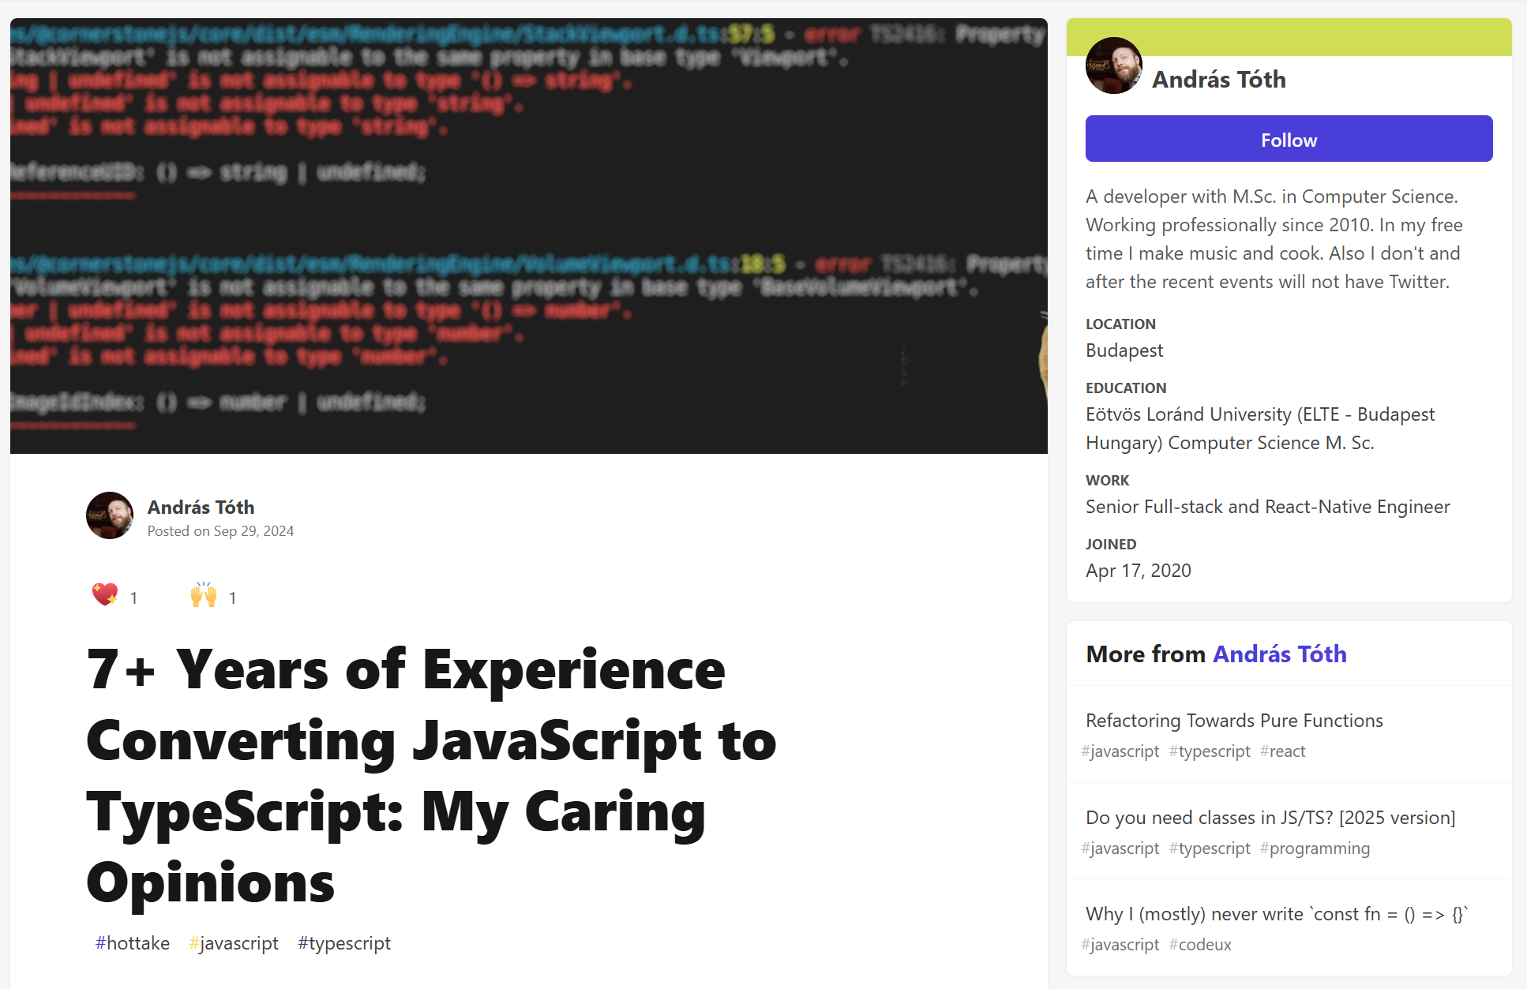
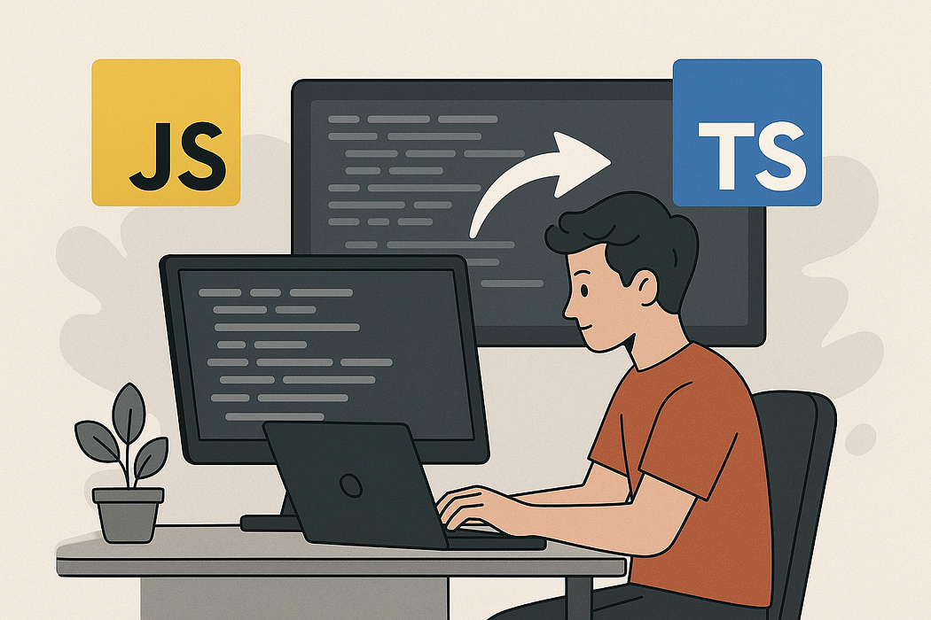
Proposed Work 2: Natural Experiment of JS→TS Migration
JavaScript projects frequently migrate to TypeScript for static typing
The migration timing may be as-good-as-random => staggered adoption DiD
No task endogeneity concerns while providing valuable evidence on static typing

Slide 41
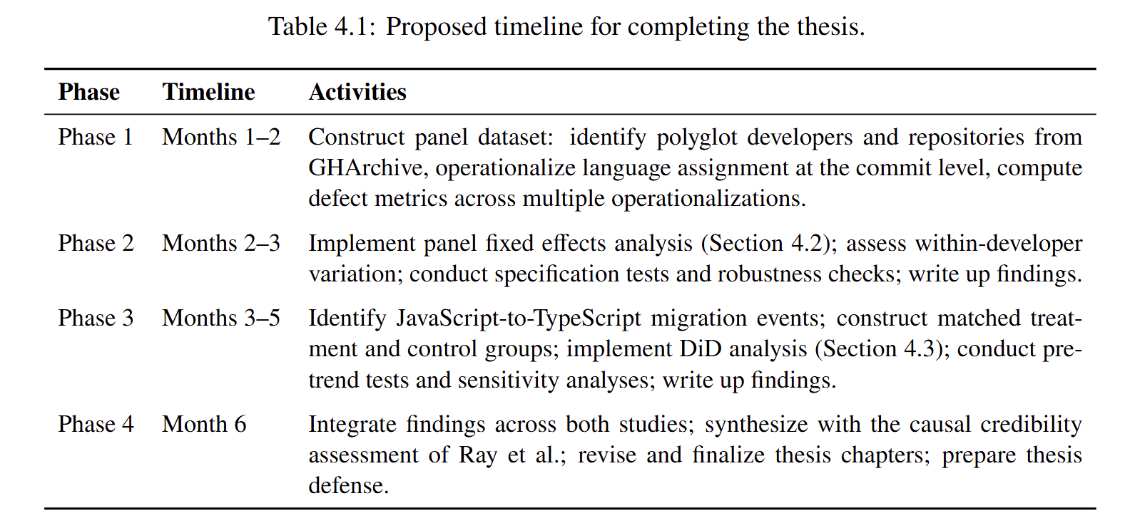
Timeline and Feasibility

Slide 42
Controlled Experiment
Natural Experiment
One may recruit participants to work on the same task with different languages
  Highest internal validity
    Randomization establish causality by design
  Lowest external validity
    Participants may not be representative of real developers
    Short term tasks may not be reflective of real projects
One may collect language migrations that happen in the wild
  E.g., C to Rust, JavaScript to TypeScript, Java to Kotlin
  Argue that treatment timing is as-good-as-random and implement a difference-in-difference design
  Trading external validity for internal validity (only a few language pairs can be studied)

Slide 43
Toward a hierarchy of causal evidence with credibility assessments
A natural experiment leveraging projects migrating from JavaScript to TypeScript
(Proposed Work)
A controlled experiment where participants build the same program using different PLs
(Prior Work)
A fixed-effect regression study on a huge number of various GitHub projects
(Proposed Work)
High Internal Validity
High External Validity

Slide 44
Summary
I argue that empirical SE research needs an explicit pragmatic framework and vocabulary for causal credibility assessments so that it can better dispel software engineering myths and inform evidence-based practice
A framework & vocabulary for assessing causal credibility in SE research
Three existing examples, each dispelling a well-known software engineering myth
  The impact of pinning vs floating on supply chain security
  The impact of buying GitHub stars for popularity growth
  The impact of adopting AI coding tools on velocity and quality
Proposed work on revisiting the programming language vs. defect proneness myth

Slide 45
Causal Directed Acyclic Graphs (DAGs)
A way of formally specifying causal relationships
Much more nuanced than what we introduce here, see: https://mixtape.scunning.com/03-directed_acyclical_graphs
Direct Relationship
Programming Language
Defect Proneness
Confounders
Task Difficulty
Mediators
Team Skill
Code Complexity
Defect Proneness
Colliders / Backdoors (not shown here for brevity)

Slide 46
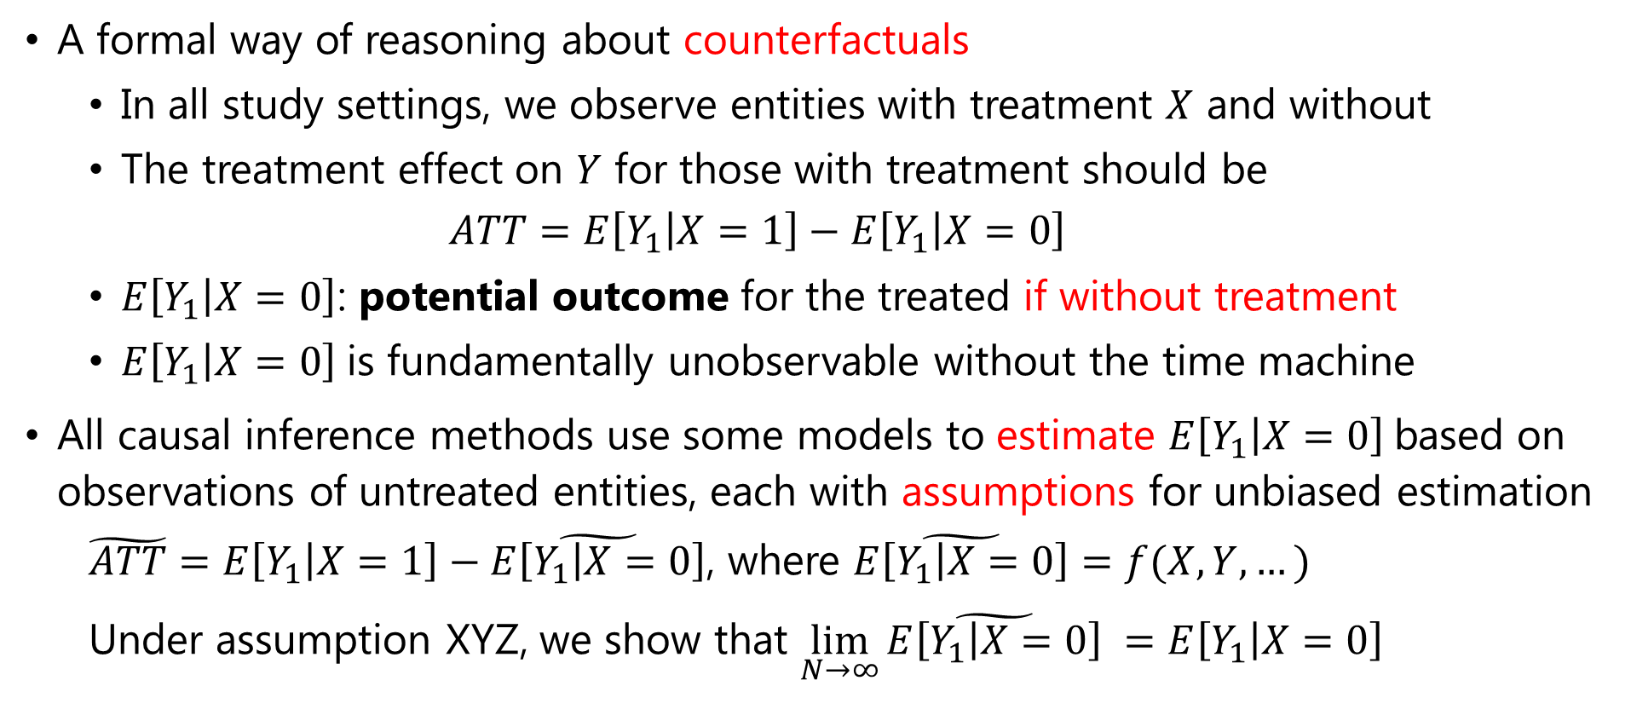
The Potential Outcome Framework
A formal way of reasoning about counterfactuals
  In all study settings, we observe entities with treatment $X$ and without
  The treatment effect on $Y$ for those with treatment should be
    $$ATT=E\left[Y_{1} | X=1\right]−E\left[Y_{1} | X=0\right]$$
  $E\left[Y_{1} | X=0\right]$: potential outcome for the treated if without treatment
  $E\left[Y_{1} | X=0\right]$is fundamentally unobservable without the time machine
All causal inference methods use some models to estimate $E\left[Y_{1} | X=0\right]$based on observations of untreated entities, each with assumptions for unbiased estimation
  $\tilde{ATT}=E\left[Y_{1} | X=1\right]−\tilde{E\left[Y_{1} | X=0\right]}$, where $\tilde{E\left[Y_{1} | X=0\right]}=f(X,Y,…)$
  Under assumption XYZ, we show that $\lim_{N→∞}{\tilde{E\left[Y_{1} | X=0\right]}} =E\left[Y_{1} | X=0\right]$

Slide 47
A (Pragmatic) Recipe for Causal Claims in Software Engineering Research
Specify a causal theory you want to test as directed acyclic graphs (DAG)
Define the potential outcome model you are using, and under what assumption the model would be able to unbiasedly estimate the causal effect
Collect appropriate data from a population to fit the model
If possible, provide explicit test of the above assumption
  those with testable underlying assumptions carry stronger internal validity
Otherwise, argue the plausibility of the above assumption
  Reason on plausibility through causal DAGs and alternative explanations
  Some models provide established plausibility tests (e.g., pre-trend for DiD)

Slide 48
The Internal-External Validity Trade-Off
Internal Validity: The extent to which a design may support a valid causal claim
External Validity: The extent to which a design can generalize to other settings
Randomized experiments have highest internal validity but lowest external validity
  Randomization supports causal interpretation by design and easily testable
  Hard to design experiments that align with reality (especially in SE research)
Observational studies have various level of internal-external validity by design
  Natural experiment and quasi-experimental settings => higher internal validity
  Large-scale studies => higher external validity but hard to make causal claims

